Slide 1
EECE 229 Introduction to Digital Systems

Slide 2
Chapter 3
Combinational Circuit

Slide 3
Overview
Combinational Circuit Analysis
Combinational Circuit Synthesis
Combinational Building Blocks
Adders
Multiplier
Decoders
Encoders
Multiplexer
Comparator

Slide 4
Combinational Circuit Analysis

Slide 5
Combinational Circuit
A circuit whose outputs at any time are determined solely on the state of current inputs.
can be specified completely by a set of Boolean expressions.

Slide 6






Boolean Expressions: (use intermediate outputs when helpful)
x
y
F1
y
z
x
y
z
z
F2

Slide 7
Boolean Expressions: (use intermediate outputs when helpful)
x
y
T1
T4
F1
F2
y
z
x
y
z
z
T2
T3
x
0
0
0
0
1
1
1
1
y
0
0
1
1
0
0
1
1
z T1 T2 T3 T4 F2 F1
0
1
0
1
0
1
0
1
0
1
2
3
4
5
6
7

Slide 8
Boolean Expressions: (use intermediate outputs when helpful)
x
y
T1
T4
F1
F2
y
z
x
y
z
z
T2
T3
F2=T3+z’
F2=xyz+z’
F1=T4F2’
F1=(T1+T2)(T3+z’)’
F1=(xy+yz)(xyz+z’)’
F1=(xy+yz)[(xyz)’(z)]
F1=(xy+yz)[(x’+y’+z’)(z)]
F1=(xy+yz)[x’z+y’z]
F1=(xy+yz)[x’z+y’z]
F1=xyx’z+xyy’z+yzx’z+yzy’z
F1=x’yz
x
0
0
0
0
1
1
1
1
y
0
0
1
1
0
0
1
1
z
0
1
0
1
0
1
0
1
T1
0
0
0
0
0
0
1
1
T2
0
0
0
1
0
0
0
1
T3
0
0
0
0
0
0
0
1
T4
0
0
0
1
0
0
1
1
F2
1
0
1
0
1
0
1
1
F1
0
0
0
1
0
0
0
0
0
1
2
3
4
5
6
7

Slide 9
Combinational Circuit Analysis Procedure
Assign a label to all internal signals.
For each labeled signal that is the output of a gate, write the function of the gate’s inputs.
Substitute functions of labels until you have the circuit output(s) as a direct function of the circuit inputs.

Slide 10
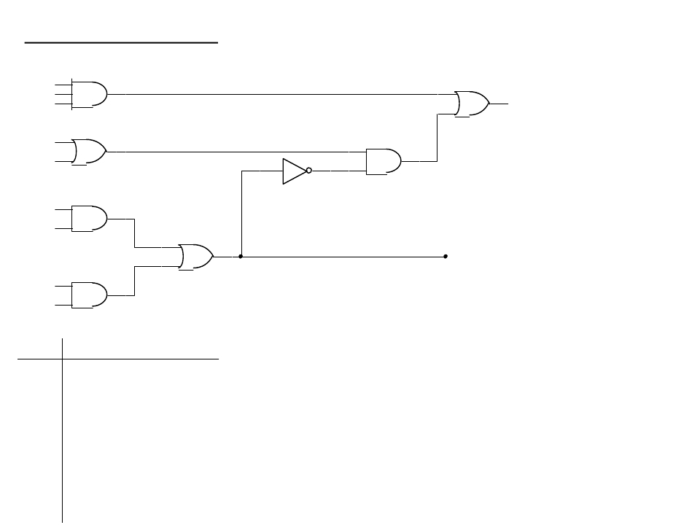
Boolean Expressions: (use intermediate outputs when helpful)
A
B
C
T1
F1
A
C
A
C
T2
T3
T5
F2
B
C
T4
A
0
0
0
0
B
0
0
1
1
C
0
1
0
1
T1
T2
T3
T4
T5
F1
F2
0
1
2
3
4
1
0
0
5
6
7
1
1
1
0
1
1
1
0
1

Slide 11
Boolean Expressions: (use intermediate outputs when helpful)
A
B
C
T1
F1
A
C
A
C
T2
T3
T5
F2
B
C
T4
A
0
0
0
0
B
0
0
1
1
C
0
1
0
1
T1
0
0
0
0
T2
0
1
0
1
T3
0
0
0
0
T4
0
0
0
1
T5
0
1
0
0
F1
0
1
0
0
F2
0
0
0
1
F2=T3+T4
F2=AC+BC
F1=T1+T5
F1=ABC+T2F2’
F1=ABC+(A+C)(T3+T4)’
F1=ABC+(A+C)(AC+BC)’
F1=ABC+(A+C)[(AC)’(BC)’]
F1=ABC+(A+C)[(A’+C’)(B’+C’)]
0
1
2
3
4
1
0
0
0
1
0
0
1
1
0
F1=ABC+(A+C)[A’B’+A’C’+B’C’+C’C’]
5
6
7
1
1
1
0
1
1
1
0
1
0
0
1
1
1
1
1
0
1
0
0
1
0
1
0
0
1
1
1
0
1
F1=ABC+AA’B’+AA’C’+AB’C’+AC’+
A’B’C+AC’C+B’C’C+C’C
F1=ABC+AB’C’+AC’+A’B’C
F1=ABC+AC’+A’B’C

Slide 12
Combinational Circuit Synthesis

Slide 13
Procedure
Determine inputs and outputs
Truth Table(s)
Simplify to desired form
Draw logic diagram
Verify

Slide 14
Example: BCD-XS5 Code Converter (1)
Design a circuit that converts a BCD-coded input to the equivalent Excess-5 code
•
From the description,
– Inputs = ABCD
– Outputs = wxyz
A B C D
w x y z
----------------
0 0 0 0 0 1 0 1
0 0 0 1 0 1 1 0
0 0 1 0 0 1 1 1
0 0 1 1
1 0 0 0
0 1 0 0
1 0 0 1
0 1 0 1
1 0 1 0
0 1 1 0
1 0 1 1
0 1 1 1
1 1 0 0
1 0 0 0
1 1 0 1
1 0 0 1
1 1 1 0
1 0 1 0
d d d d
1 0 1 1
“ “
1 1 0 0
“ “
1 1 0 1
“ “
1 1 1 0
“ “
1 1 1 1
“ “

Slide 15
Example: BCD-XS5 Code Converter (2)
CD00
AB
01
11
10
0 | 1 | 3 1 | 2
4 1 | 5 1 | 7 1 | 6 1
12 d | 13 d | 15 d | 14 d
8 1 | 9 1 | 11 d | 10 d
00
01
A’
B’
w(ABCD)
11
10
C
D
w(ABCD) = A + B + CD

Slide 16
Example: BCD-XS5 Code Converter (3)
CD00
AB
01
11
10
0 1 4 | 1 1 5 | 3 7 1 | 2 1 6
12 d | 13 d | 15 d | 14 d
8 1 | 9 1 | 11 d | 10 d
00
01
11
10
x(ABCD) = B’C’ + BCD + B’D’
B’
C’
B
C
D
B’
D’
x(ABCD)

Slide 17
Example: BCD-XS5 Code Converter (4)
CD00
AB
00
01
11
10
0 | 1 1 | 3 | 2 1
4 | 5 1 | 7 | 6 1
12 d | 13 d | 15 d | 14 d
8 | 9 1 | 11 d | 10 d
C’
D
y(ABCD)
01
11
10
C
D’
y(ABCD) = C’D + CD’

Slide 18
Example: BCD-XS5 Code Converter (5)
CD00
AB
00
01
11
10
01
11
10
0 1 | 1 | 3 | 2 1
4 1 | 5 | 7 | 6 1
12 d | 13 d | 15 d | 14 d
8 1 | 9 | 11 d | 10 d
D’
z(ABCD)
z(ABCD) = D’

Slide 19
Combinational circuit Building blocks

Slide 20
Overview
Adders & Substractors
Multiplier
Decoder
Encoder
Multiplexer

Slide 21
Adders
An adder combines two operands using the rules of addition
The same rules and adders work on unsigned and signed (2’s-complement) numbers
A simple adder is the half adder, with addition of only two bits, which produces a half sum and a carry out
Full adders can be formed by combining multiple half adders (with a carry-in)
Notes:
An adder can perform subtraction by complementing the subtrahend (the number being subtracted) and adding it to the minuend.

Slide 22
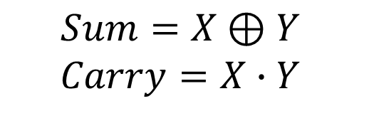
Half Adder (addition of two bits)
X | Y | Sum | Carry
0 | 0 | 0 | 0
0 | 1 | 1 | 0
1 | 0 | 1 | 0
1 | 1 | 0 | 1
$$Sum=X⊕Y$$
$$Carry=X∙Y$$

Slide 23



Half Adder
$$HS=X⊕Y$$
$$HS=X∙\overline{Y}+\overline{X}∙Y$$
$$CO=X∙Y$$
Notes:
HS: Half sum
CO: Carry out

Slide 24
Full Adder
When larger numbers that have multiple bits.
Consider a truth table with each pair of bit
0
+ 0
-----
0
0
+ 1
-----
1
1
+ 0
-----
1
1
+ 1
-----
10

Slide 25
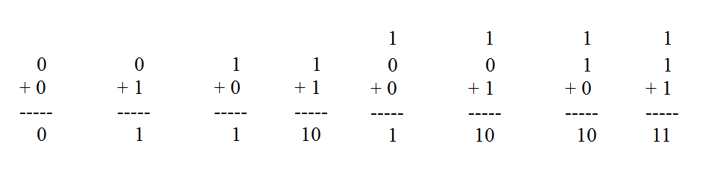
Truth table:
Note:
Z - carry in (to the current position)
C - carry out (to the next position)
Using K-map, simplified SOP form is:
C = XY + XZ + YZ
S = X'Y'Z + X'YZ'+XY'Z'+XYZ
S = Σm(1,2,4,7)
C = Σm(3,5,6,7)
Sum
Carry
X
X
YZ
0
1
YZ
0
1
00
0
1
00
0
0
0
4
0
4
01
1
0
01
0
1
1
5
1
5
Z
11
0
1
11
1
1
3
7
3
7
10
1
0
10
0
1
2
6
2
6

Slide 26
Full Adder
Using K-map, simplified SOP form is:
C = XY + XZ + YZ
S = X'Y'Z + X'YZ'+XY'Z'+XYZ
We develop alternative formulae in terms of ⊕ using algebraic manipulation:
C = XY + XZ + Y = XY + (X + Y)Z distr. law
= XY + [ (X + Y)(1)]Z
= XY + [(X + Y)((XY)’+(XY))] Z Thm.5
= XY + [(X + Y)(XY)’+ (X + Y)(XY)] Z distr.
= XY + [(X + Y)(XY)’+ XXY+XYY] Z distr.
= XY + [(X + Y)(XY)’+ XY] Z Thm.3, 3D
= XY + [(X⊕Y) + XY] Z defn. of ⊕
= XY + (X⊕Y)Z + XYZ distr.
= XY + (X⊕Y)Z Thm.10

Slide 27
Full Adder
S = X'Y'Z + X'YZ' + XY'Z' + XYZ
= X'(Y'Z + YZ') + X(Y'Z' + YZ) distr.
= X'(Y⊕Z) + X(Y⊕Z)‘ defn. of ⊕
= X⊕(Y⊕Z) defn. of ⊕
= X⊕Y⊕Z assoc. law for ⊕

Slide 28
Full Adder
Circuit for above formula:
C = XY + (X⊕Y)Z
S = X⊕Y⊕Z
(X⊕Y)
X
Y
S
(XY)
C
Z
Full Adder made from two Half-Adders (+ OR gate).

Slide 29
Full Adder
Block diagrams.
X
Y
X
Y
Sum
(X⊕Y)
X
Y
Sum
S
Half
Adder
Half
Adder
Carry
(XY)
Carry
CO
CIN
Full Adder made from two Half-Adders (+ OR gate).
X
S
Y
H.A.
CIN
CO

Slide 30
Ripple Carry Adder
Use multiple full adders to add N-bit numbers.
Each full adder inputs a C_{in}, which is the C_{out} of the previous adder.
This kind of adder is called a ripple-carry adder, since each carry bit "ripples" to the next full adder.
Note that the first (and only the first) full adder may be replaced by a half adder (under the assumption that C_{in} = 0).
Notes:
Ripple adders are simple to construct and easy to understand, but they are slow due to the carry bit having to “ripple” through each successive stage.

Slide 31
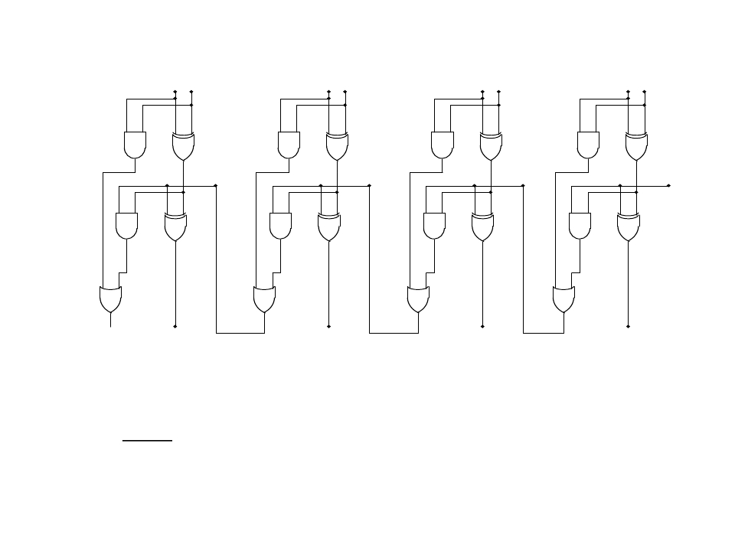
Timing and Carry propagation: Standard 4-bit ripple adder
B3 A3
B2 A2
B1 A1
B0 A0
C3
C2
C1
C0
C4
S3
S2
S1
S0

Slide 32
Problems of Ripple Carry Adder
the carry bits take time to propagate through the adder.
could choose faster logic to reduce delay
the approach is to separate out the dependencies of the carry bits on one another,
this will require additional circuitry for each carry bit

Slide 33
Reconsider Full Adder
Circuit for above formula:
C = XY + (X⊕Y)Z
S = X⊕Y⊕Z
(X⊕Y)
X
Y
S
(XY)
C
Z
Change input symbol to represent multiple bits:
X -> A_{i}
Y –> B_{i}
Z -> C_{i}
C -> C_{i+1}
S -> S_{i}

Slide 34
Reconsider Full Adder
Carry propagate: propagation of C_{i} to C_{i+1}.
P_{i} = (A_{i} ⊕ B_{i} )
A_{i} B_{i}
S_{i}
C_{i+1}
C_{i}
G_{i}=(A_{i} B_{i} )
Carry generate: produce 1 when both A_{i} and B_{i} are 1.
S_{i} = (A_{i} ⊕ B_{i} ) ⊕ C_{i} = P_{i} ⊕ C_{i}
C_{i+1} = A_{i} B_{i} + (A_{i} ⊕ B_{i} ) C_{i} =G_{i} + P_{i} C_{i}

Slide 35
Carry Look-ahead
S_{i} = (A_{i} ⊕ B_{i} ) ⊕ C_{i} = P_{i} ⊕ C_{i}
C_{i+1} = A_{i} B_{i} + (A_{i} ⊕ B_{i} ) C_{i}
=G_{i} + P_{i} C_{i}
C1=G0+P0C0
C2=G1+P1C1=G1+P1(G0+P0C0)
C3=G2+P2C2=G2+P2(G1+P1(G0+P0C0))
G2+P2G1+P2P1G0+P2P1P0C0

Slide 36
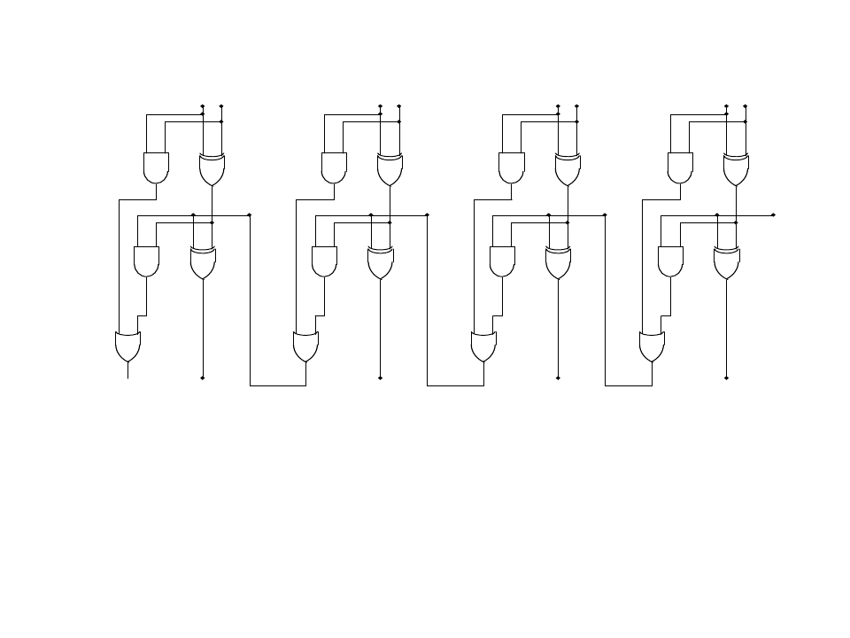
Timing and Carry propagation: Standard 4-bit ripple adder
B3 A3
B2 A2
B1 A1
B0 A0
G3
P3
G2
P2
G1
P1
G0
P0
C3
C2
C1
C0
C4
S3
S2
S1
S0
Ci+1 = G + PCi
C1=G0+P0C0
C2=G1+P1C1=G1+P1(G0+P0C0)
C3=G2+P2C2=G2+P2(G1+P1(G0+P0C0))
G2+P2G1+P2P1G0+P2P1P0C0

Slide 37
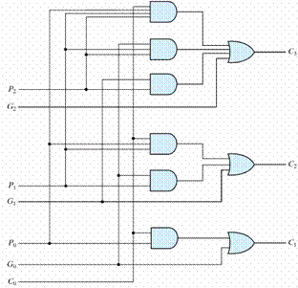
Logic Diagram of Carry Look-ahead Generator

Slide 38
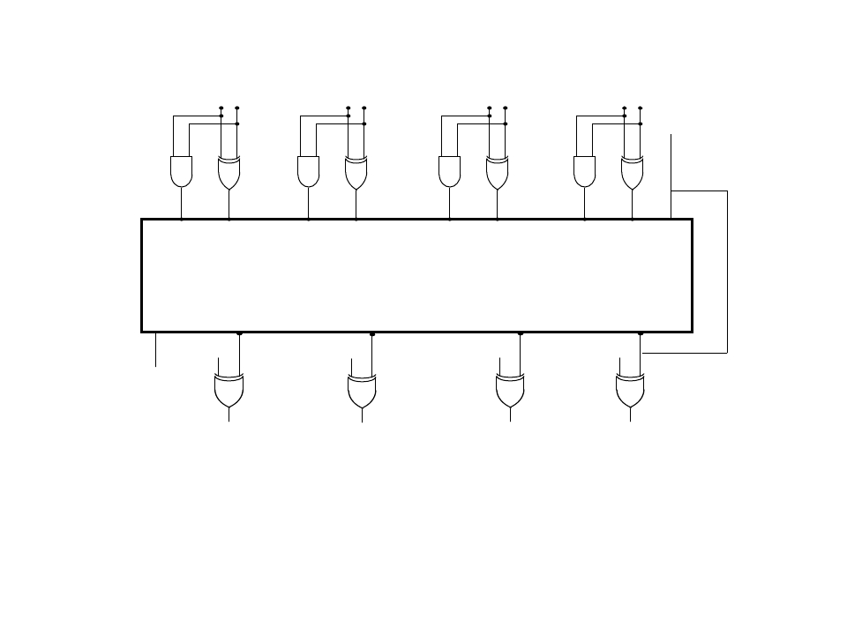
4-Bit Adder with Carry Look-ahead
B3 A3
B2 A2
B1 A1
B0 A0
C0
G3
P3
G2
P2
G1
P1
G0
P0
Carry Lookahead Generator
C4
C3
C2
C1
P3
P2
P1
P0
C4
S3
S2
S1
S0

Slide 39
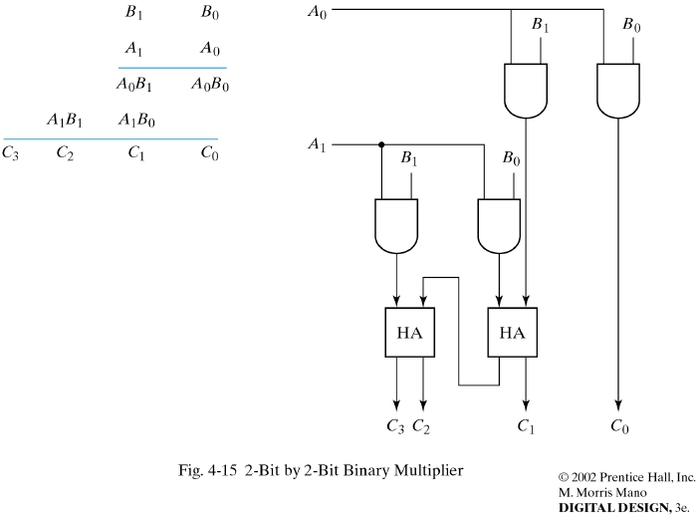
Binary Multiplier
B₁ B₀ Multiplicand bits
A₁ A₀ Multiplier bits

Slide 40
Rules for constructing multiplier
For J multiplier bits, K multiplicand bits:
We need J*K AND gates
(J -1) K-bit adders
Produce a product of (J + K) bits

Slide 41
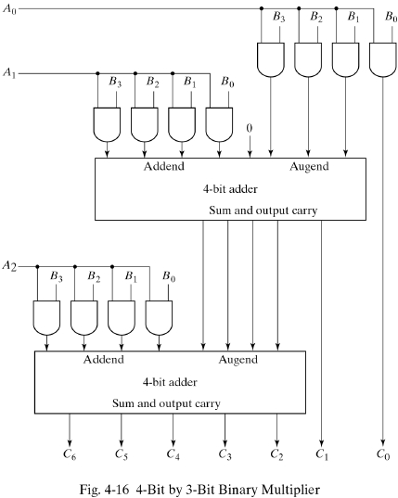
Larger multiplier using 4-bit adders as components

Slide 42
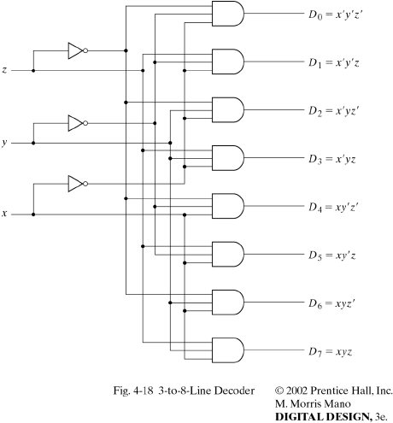
Decoders
An “n-to- 2^{n} ” decoder has n inputs and 2^{n} outputs.
When the binary number “x” is input, output “x”=1; the rest of the outputs = 0.
x y z D0 D1 D2 D3 D4 D5 D6 D7
------------------------------
0 0 0 1 0 0 0 0 0 0 0
0 0 1 0 1 0 0 0 0 0 0
0 1 0 0 0 1 0 0 0 0 0
0 1 1 0 0 0 1 0 0 0 0
1 0 0 0 0 0 0 1 0 0 0
1 0 1 0 0 0 0 0 1 0 0
1 1 0 0 0 0 0 0 0 1 0
1 1 1 0 0 0 0 0 0 0 1

Slide 43
Decoders
w
0
y
0
n
inputs
2
n
w
n
–
1
outputs
Enable
y
2
n
–
1
En
An n-to-2^{n} binary decoder.

Slide 44
En
w
w
y
y
y
y
1
0
0
1
2
3
w
y
1
0
0
1
0
0
0
0
0
w
y
1
0
1
0
1
0
0
1
1
y
1
1
0
0
0
1
0
2
En
y
1
1
1
0
0
0
1
3
0
x
x
0
0
0
0
(a) Truth table
(b) Graphical symbol
w
0
y
0
w
1
y
1
y
2
y
3
En
(c) Logic circuit
A 2-to-4 decoder.

Slide 45
Combining Decoders
w
w
y
y
0
0
0
0
w
w
y
y
1
1
1
1
y
y
w
2
2
2
En
y
y
3
3
En
w
y
y
0
0
4
w
y
y
1
1
5
y
y
2
6
En
y
y
3
7
A 3-to-8 decoder using two 2-to-4 decoders.

Slide 46
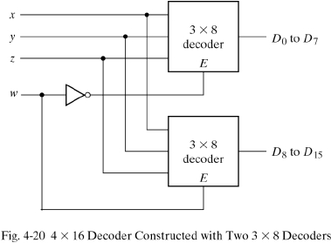
Combining Decoders

Slide 47
w
w
y
y
0
0
0
0
w
w
y
y
1
1
1
1
y
2
y
2
En
y
3
y
3
w
y
y
4
0
0
w
y
y
5
1
1
y
2
y
6
w
w
y
y
y
2
0
0
En
3
7
w
w
y
3
1
1
y
2
En
En
y
w
y
y
8
3
0
0
w
y
y
9
1
1
y
2
y
10
En
y
3
y
11
w
y
y
12
0
0
w
y
y
13
1
1
y
2
y
14
En
y
3
y
15
A 4-to-16 decoder built using a decoder tree.

Slide 48
Encoders
The inverse of a decoder. Set input line number “n” = 1, and the output is the binary-encoded value “n”.
D0 D1 D2 D3 D4 D5 D6 D7 x y z
---------------------------------------
1 0 0 0 0 0 0 0 0 0 0
0 1 0 0 0 0 0 0 0 0 1
0 0 1 0 0 0 0 0 0 1 0
0 0 0 1 0 0 0 0 0 1 1
0 0 0 0 1 0 0 0 1 0 0
0 0 0 0 0 1 0 0 1 0 1
0 0 0 0 0 0 1 0 1 1 0
0 0 0 0 0 0 0 1 1 1 1
x = D4 + D5 + D6 + D7
y = D2 + D3 + D6 + D7
z = D1 + D3 + D5 + D7
Limitations:
Only one input can be active at any given time. If two inputs are active simultaneously, the output produces an undefined combination!
For instance: D3 and D6 are 1 simultaneously, produce 111.
The same output when all inputs are 0 or D0=1.

Slide 49
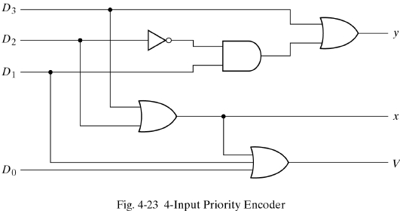
Priority Encoders
D0 D1 D2 D3 x y VALID
-----------------------
0 0 0 0 d d 0
1 0 0 0 0 0 1
d 1 0 0 0 1 1
d d 1 0 1 0 1
d d d 1 1 1 1

Slide 50
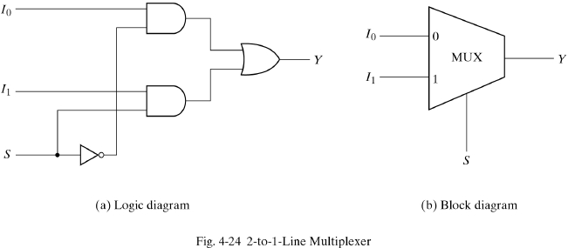
Multiplexers
A multiplexer (or “Mux”) has multiple data inputs, a control input (which may consist of several signals) and one output. The value on the control inputs selects one data input, which is passed to the output.
Data
Inputs
Control
Input

Slide 51
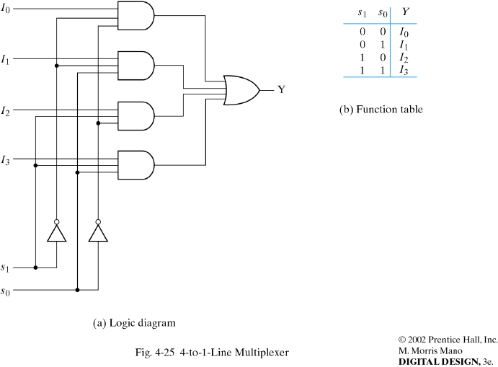
Multiplexers

Slide 52
Implementing Boolean functions with Muxes
A Mux with 2^{n} data inputs and n-1control lines can be used to implement a Boolean function of n variables.
d
Comb
Logic
Mux
f(a,b,c,d)
a bc

Slide 53
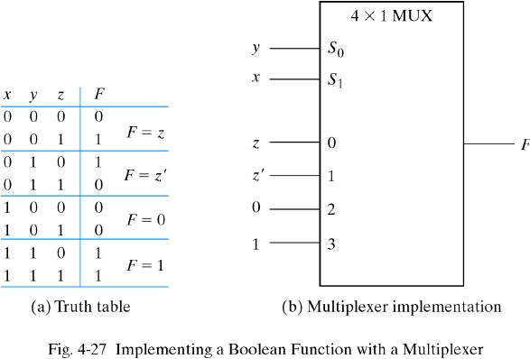
An example
F(xyz) = m(1,2,6,7)

Slide 54
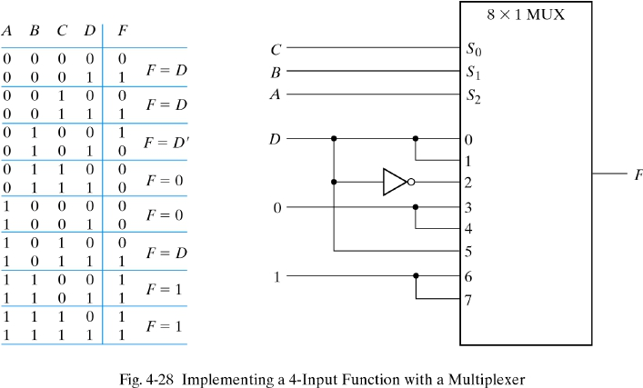
Another example

Slide 55
Conclusion
Know how to analyze a combinational circuits by deriving boolean expressions
Know how to synthesize combinational circuits of multiple outputs by given truth table
Know the truth table and circuits of multiplier, decoder, encoder, multiplexer.

